Slide 1


5 Domains of Writing

Slide 2
Review
What does it mean to focus in regards to writing?
Writing about a specific clear point with an awareness of task
What does it mean to write with strong content in regards to writing?
Descriptive writing using colorful adjectives and strong nouns

Slide 3
Organization
Organization: The order developed and sustained within and across paragraphs using transitional devices and including introduction and conclusion

Slide 4
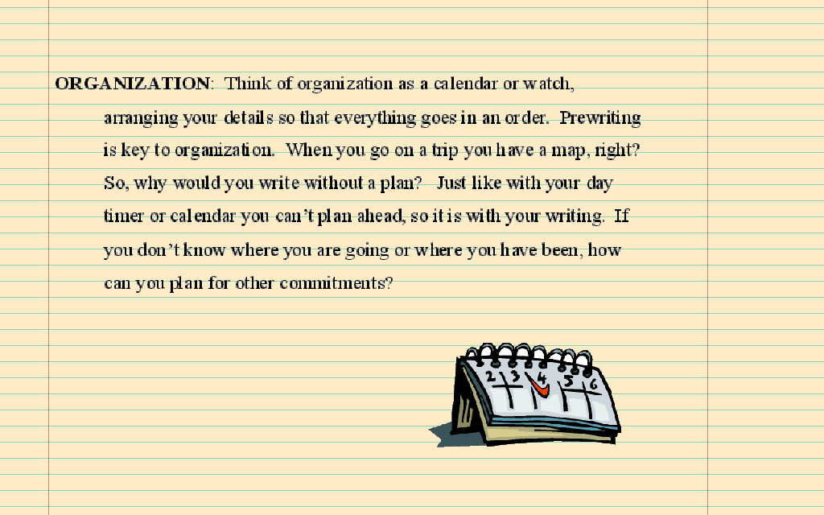

Slide 5
How do you write with strong organization?
A writer who has strong organization writes with a sophisticated arrangement of content with evident and/or subtle transitions.

Slide 6
Organization
Key word: flow
Concerns the arrangement of content
Transitions must be used – between sentences and paragraphs
There should always be an intro and conclusion
Information should be arranged logically (chronological, least to most important, most to least important, cause/effect, etc.)

Slide 7
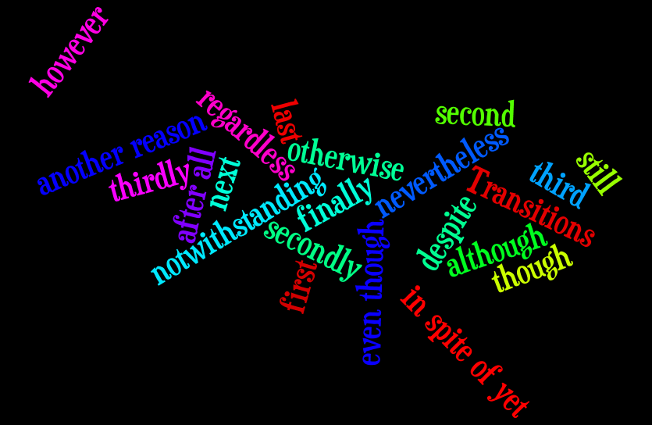
Transition Word Splash

Slide 8
Shark Attack Article Activity: (15 minutes)
Directions: in your notebook, write the following statements in the order you believe to be correct.
The incident was reported all over the world...
The boy lived.
The shark finally had to be surgically removed…
It was unfortunate, but the report failed to mention…
This occurred in Florida…
In fact, it wasn’t until the boy grabbed it by the tail…
It was listed here in the newspaper report under the heading…
The second point was that the boy harassed the shark.
The boy could not get the shark to release its grip…
The first point was that the shark was only 21 inches…
The shark died.
In April 1998, a shark bit a 16 year old boy…

Slide 9
